Slide 1
Nikos Kastrinos, Team Leader Foresight , European Commission, DG RTD
PUBLIC SECTOR FORESIGHT NETWORK (PSFN)
31 July 2019, Centra Technology, Inc. | 4121 Wilson Blvd. Suite 200 – Conf. Center| Arlington, VA

Slide 2

What is foresight?
Definitions:
Foresight is the ability to predict the future
Foresight is the disciplined analysis of alternative futures
Foresight is a systematic, participatory, future-intelligence-gathering and medium-to-long-term vision-building process aimed at present-day decisions and mobilising joint actions.
Anecdotes:
Between “forecasting” and “action research”
Between science and policy (e.g. somehow related to "evidence based policy")
"Technology Assessment" with a positive outlook ☺
What, with hindsight, we wish we had….
Foresight in policy:
A structured preoccupation with the future
A decision-support instrument
A way of building reflexivity into strategy-making

Slide 3
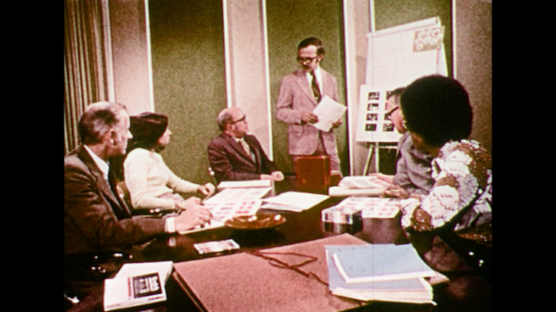
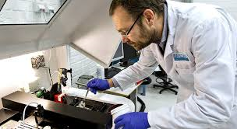
Three phases in the history of foresight and EU R&I policy
1978-1994: FAST
1994-2010: Grants for foresight
research projects in the programme
for socio-economic sciences
2010 – today: decentralized funding and emphasis in use and usefulness
EFFLA and foresight in strategic planning

Slide 4
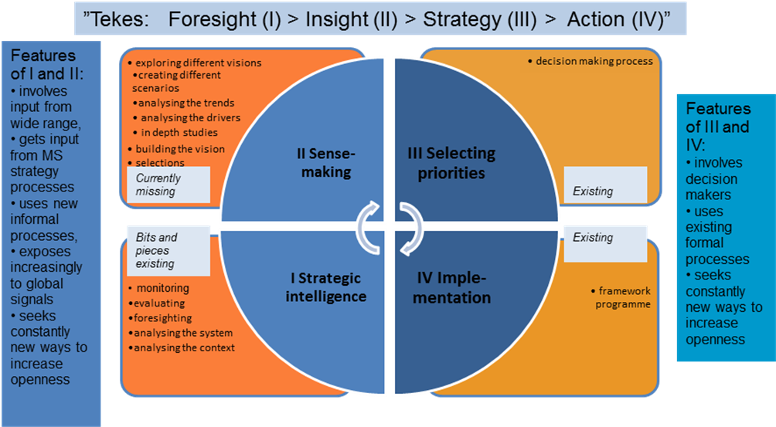
The advice of EFFLA: Foresight in strategic planning

Slide 5
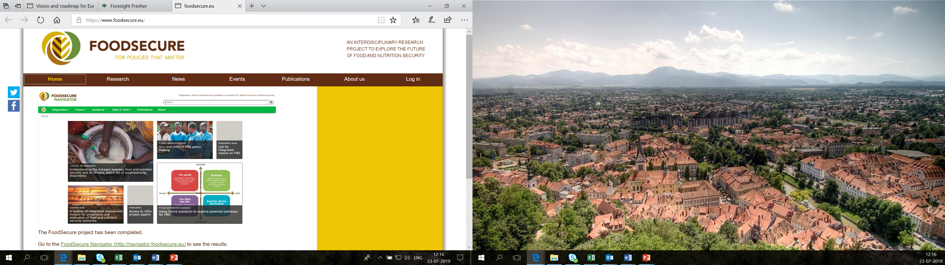
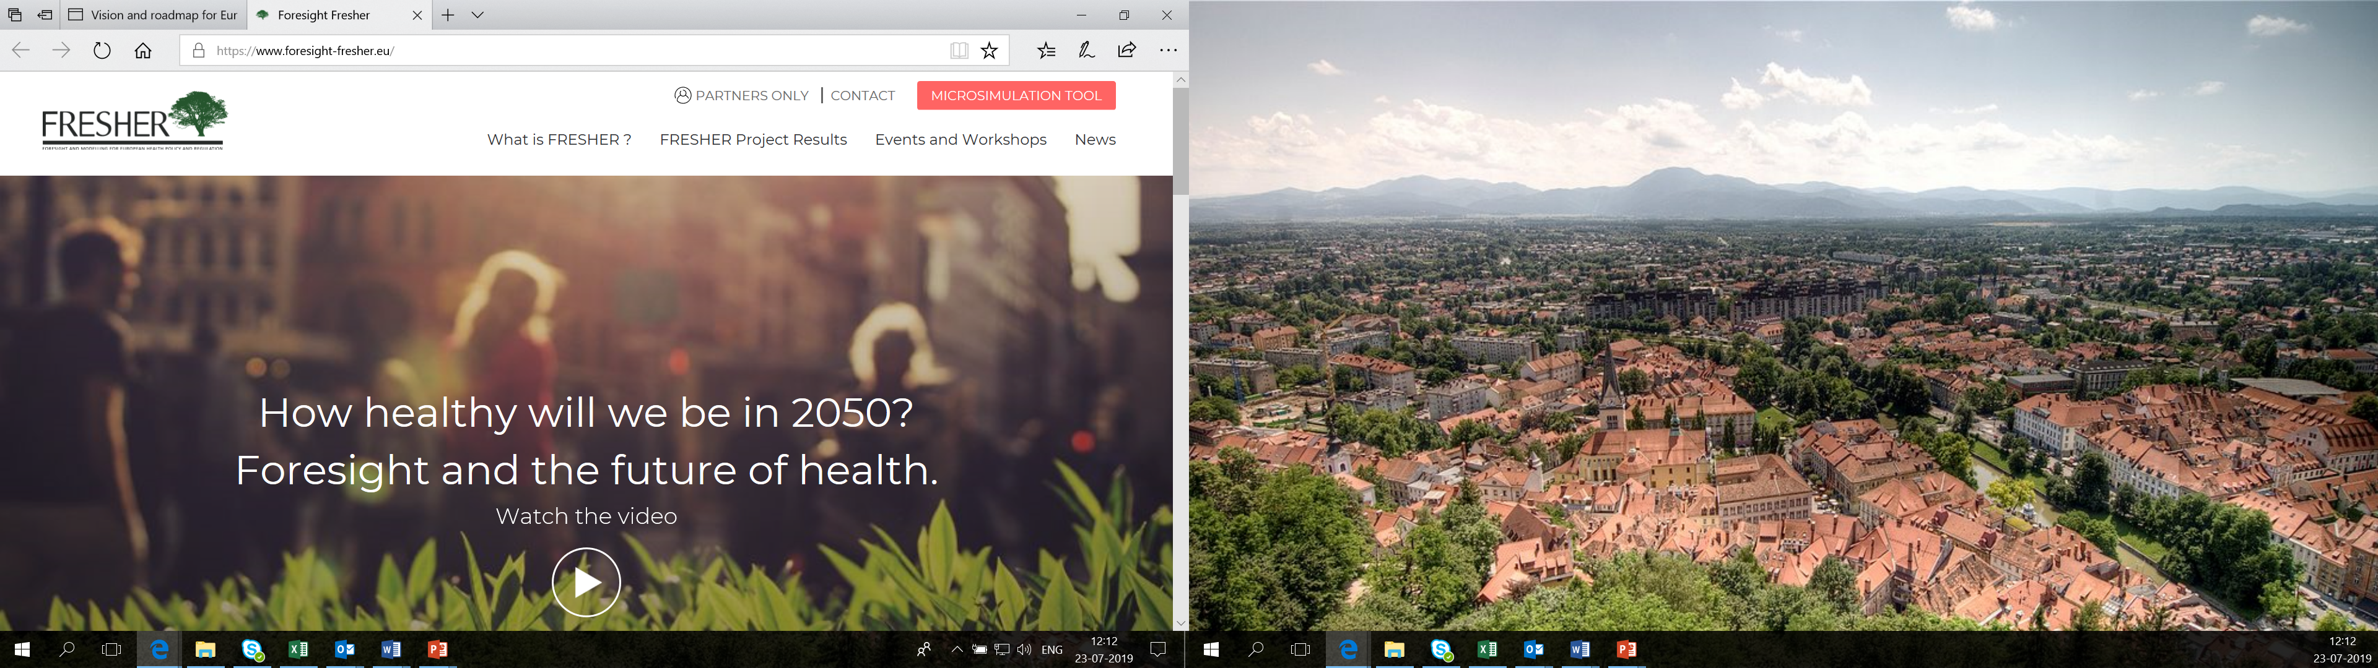
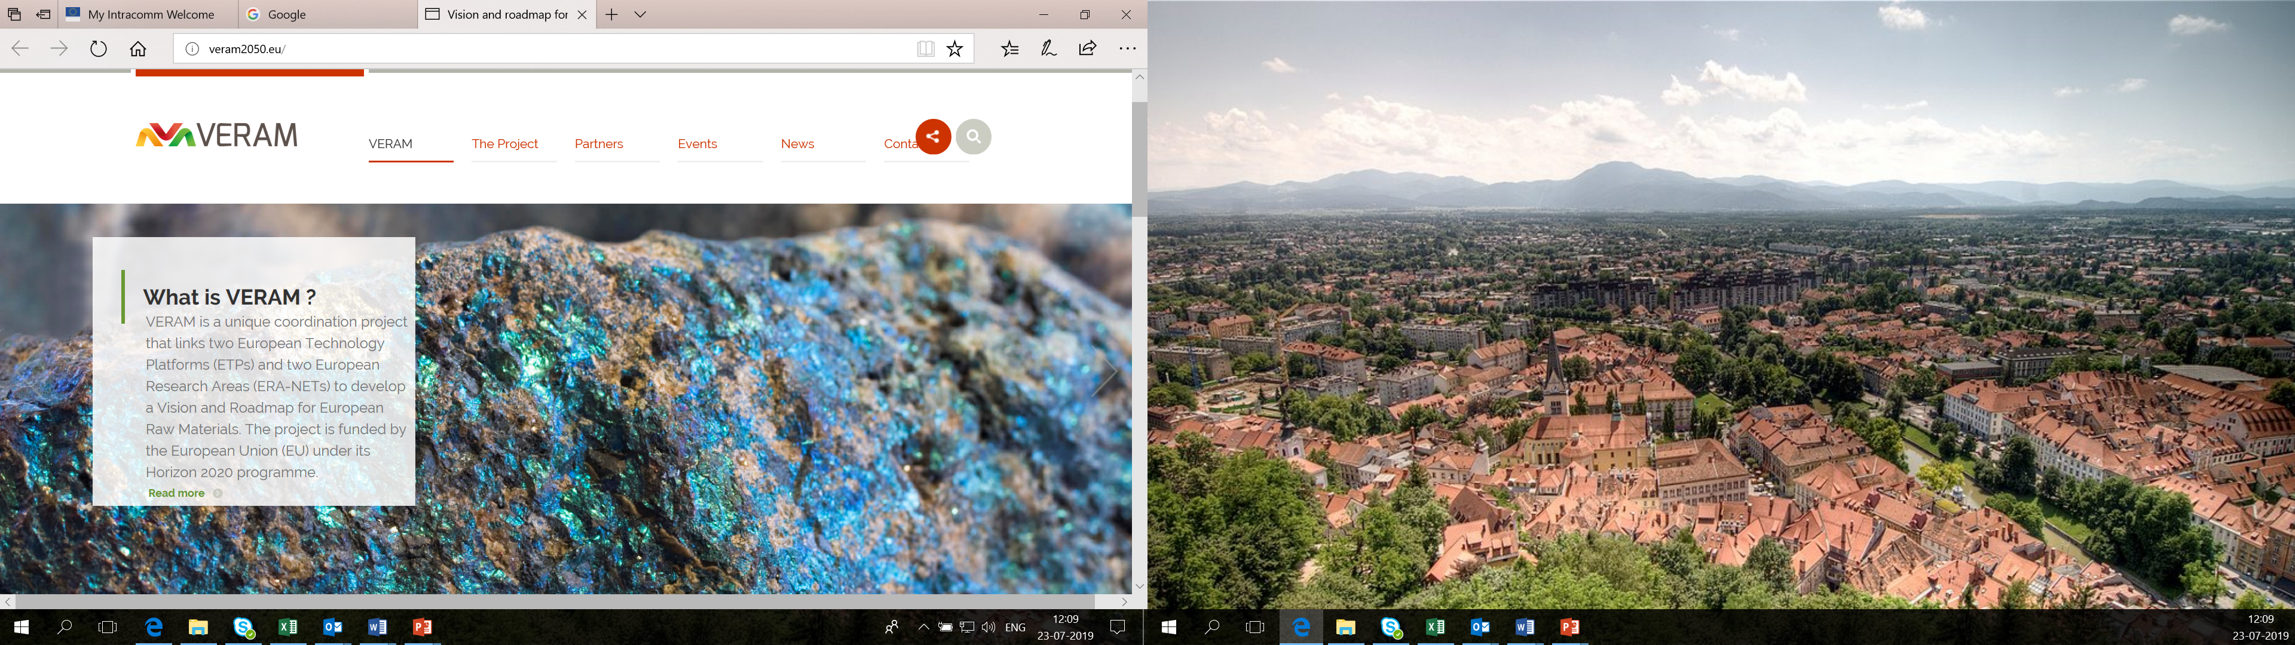
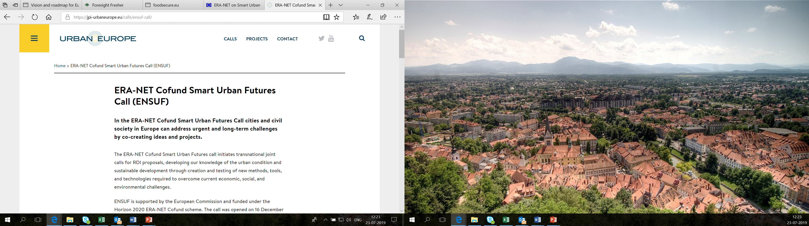
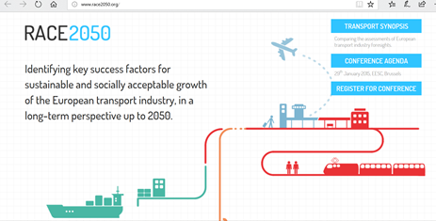
Current R&I investment in foresight:
About € 10-15M pa across the Framework Programme

Slide 6
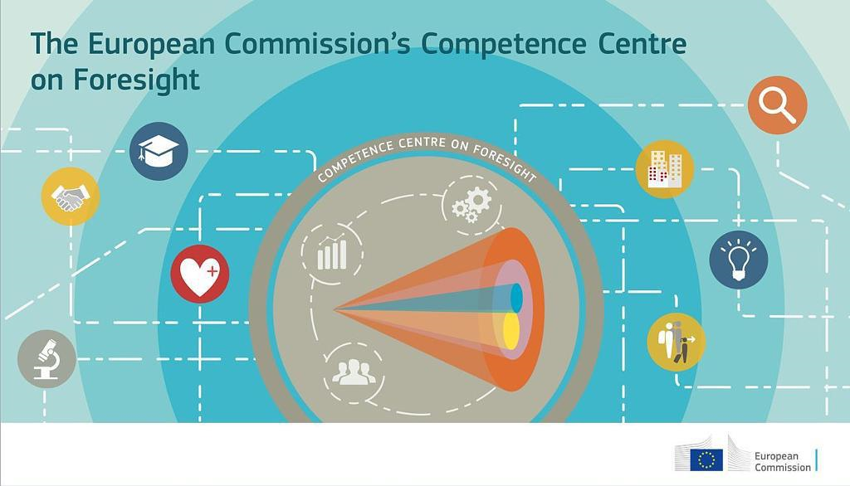

The current foresight scene in the European Commission
Joint Research Centre
European Political Strategy Centre
DG RTD Foresight Team

Slide 7

The network of foresight correspondents of the European Commission
An inter-service network aiming to:
bring foresight in the strategic planning of EU R&I policy
coordinate foresight in Horizon 2020
Improve the use of foresight resources across the Commission
Bringing together all departments of the European Commission

Slide 8
The BOHEMIA project
Beyond the Horizon: Foresight to support the preparation of the EU Framework Programme for R&I (2021-2027)

Slide 9

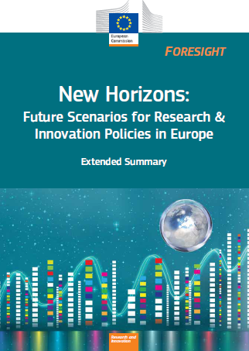
THE BOHEMIA PROJECT
A project aiming to support a policy proposal
With foresight and engagement
Carried out by contractors with a lot of involvement of EU Staff
Phase 1:
Extensive review of available foresight to produce meta-scenarios relevant for Europe (2016)
Phase 2:
Delphi survey to gain insights on future technologies, societal issues, and R&I practices (May – June 2017)
Phase 3:
Analysis, public consultation and policy recommendations (Report and 19 individual scenarios published in June 2018)
Research and innovation

Slide 10
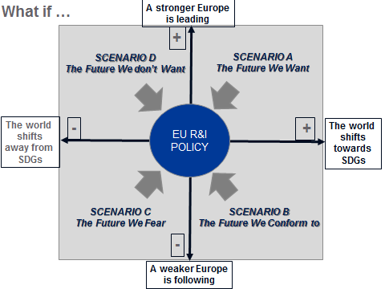
The meta-scenarios framework

Slide 11
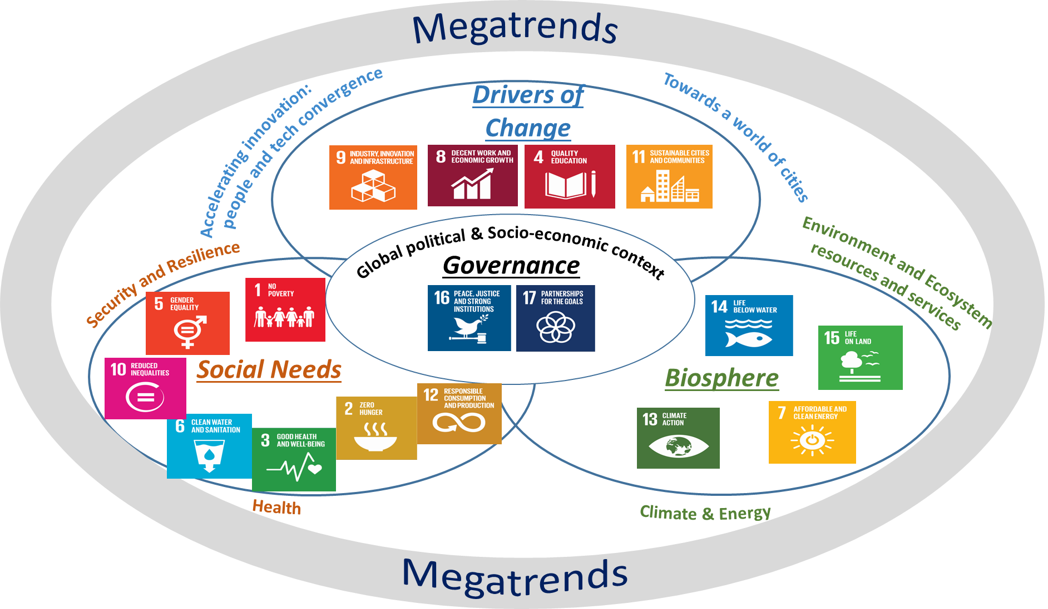
Scenarios, trends and transitions

Slide 12
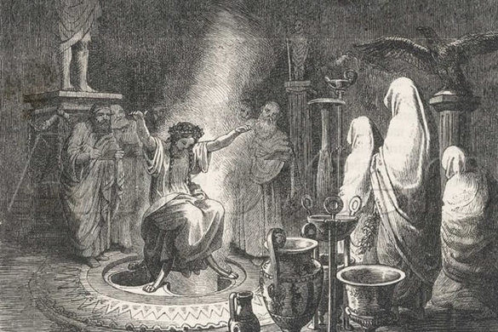
The BOHEMIA Delphi
147 Statements
9 Groups of statements on developments in S&T
7 Groups of statements on socio-economic developments driving R&I
Assessment
Time horizon of realisation + arguments
Significance for R&I / for R&I policy + arguments
Interpretation
„Likely“: Significant and likely realisation by 2040
„Uncertain“: Significant, but uncertain time frame of realisation
„Wildcards“: Unlikely realisation, but potentially high significance if realised

Slide 13
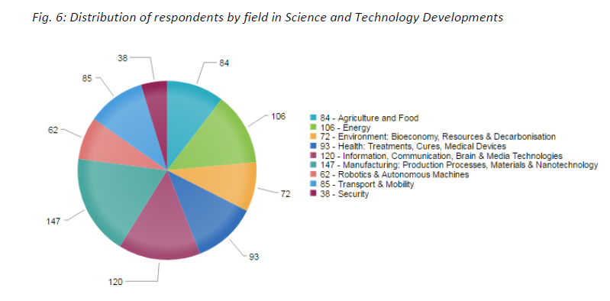
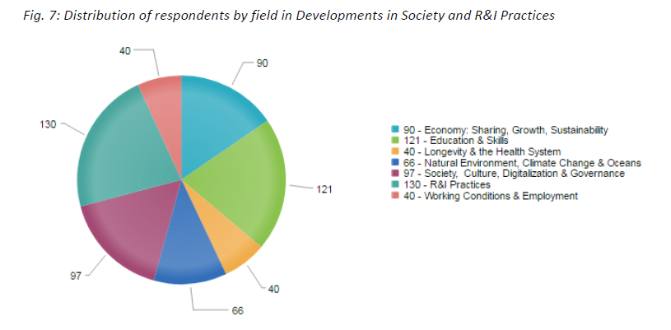
Response to the Delphi
1391 completed groups of statements
From 727 users of which 133 revised their scores and arguments at least once

Slide 14

19 “scenarios”: stories based on “likely” Delphi statements
Future of Knowledge Production
Nano-to-Macro Integral Manufacturing
The electro-sphere of sensors
Ambient Emotional intelligence
Continuous Cyberwar
Advanced ICT-based security
Re-framing Work
Diversified Food Supply sources:
Assisted living / Autonomous living
Human organ replacement
Precision medicine
Defeating communicable diseases
Smart, Sustainable Mobility
Low-Carbon economy
Bio-economy
Cheap Renewable Energy
Material efficiency
Nature valued
Decision-making supported by open expert systems

Slide 15

Public consultation on the R&I policy implications of the 19 scenarios
‘In the prospect of this scenario, to what
extent should the European Union invest
in Research and Innovation (R&I)?’
In light of your response to the previous question,
what should be the key directions for EU R&I policy?
747 Respondents /
more than 500 volunteered overwhelmingly positive comments

Slide 16
Some key contributions of BOHEMIA
Content to our vision
SDGs / Transitions / Europe leading from the front
Reflexive policy process: did we consider all that has European added value? Did we miss anything? Are we sure?
Content for the search for appropriate objectives and R&I agendas
Using the recommendations to help the orientations of the programme
Using the Delphi Data and the scenarios in arguments relating to missions, objectives and programme directions
A new way of consulting with people

Slide 17
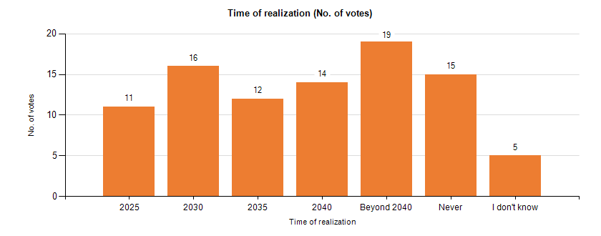
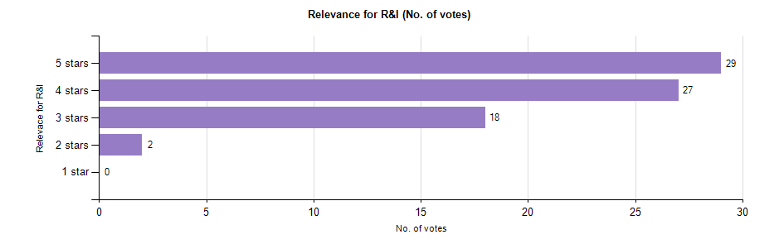
"Annual production of plastic in the EU is reduced to less than 20m tons (from 55m tons in 2009)"
“A Petrol-Plastic Waste-free Europe by 2025”
Plastic production is still increasing. | 54
There is still a need in specialized plastics (functional, biodegradable etc.), plus in collecting and recycling. | 53
New materials to replace plastic are needed. | 36
Plastic will remain in use to protect food and prevent food waste. Development of fully recyclable consumer will reduce the need for virgin plastic. | 21
Alternatives to plastic are not yet as inexpensive and high-performance, and will remain so without focused research & development. | 11
 | 5
 | 5
New technologies have to be developed, in order to increase the recycling rate or to decrease the overall quantity on plastic products. | 69
Alternatives for the current plastics have to be developed. | 54
To reduce plastic production, use policies need to forbid specific plastic applications or make it very expensive. | 26
R&I should focus on compostable biomaterials. The wide variety of plastic formulations means recycling will never be economical; compostables need no sorting, so they can be economical. | 14

Slide 18
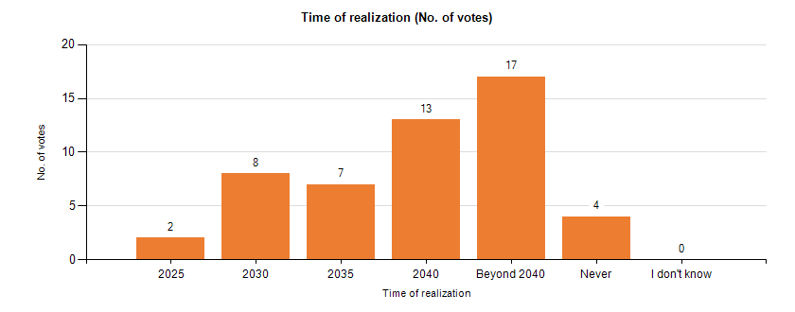
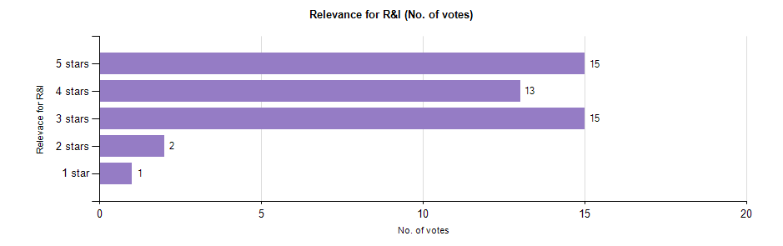
"More than 90% of all materials and waste is physically recycled or re-used energetically in the circular economy"
“A Petrol-Plastic Waste-free Europe by 2025”
Current recycling rates vary widely depending on the waste stream or country. A single figure of 90% may too ambitious in some cases. | 27
The European Commission's Circular Economy Package includes a common EU target for recycling 65% of municipal waste by 2030. | 26
A high level of recycling requires massive investment. | 23
As consistent progress has been made in life-cycle assessment methodologies, there will be more public pressure to recycle and reuse. | 20
This figure can only be achieved if it includes the reuse and service-life extension of goods, which prevents waste rather than manage it. | 16
Large scale utilisation of bio-waste is a clear trend. | 11
There is need for more efficient recycling technologies, among others because this is a promising market, which makes it an area that is therefore ripe for research. | 33
Life Cycle Assessment for sustainable production needs a standardised approach in order to provide consistent results to policy makers. | 26
There is a need for more efficient and non-destructive collection of end-of-life goods as well as new sorting techniques for material mixes to achieve a high purity of the materials to be recycled. | 14
RI is needed to delink atoms instead of recycling waste, resulting in high purity resources instead of secondary materials, e.g. depolymerisation, delaminating, de-coating, de-volcanisation of tyres. | 10

Slide 19
What difference did it make?
It has made the EC proposal a little better than it would have been otherwise.
It helped establish an image of the Commission as a potentially reflexive policy organization …
…. which is a lot to live up to: a huge challenge for the future and for EU foresight
It paved the way for new foresight to support policy:
RIBRI

Slide 20
Thank you for your attention!
http://ec.europa.eu/research/foresight/

