Slide 1





Strategy Work Sessions
Federal Foresight Community of Interest
October 24, 2019 Speaker: Doug Maris

Slide 2
Agenda
Time | Exercise Topics
11:15 – 12:00 | Exercise #1 - Environmental Scanning Tips and Techniques Breakout: Build out Trend Cards related to U.S. Government Inter-Agency future opportunities and threats; Place opportunities within Ansoff’s Grid
12:00 – 12:45 | Lunch (on own)
13:00 – 13:45 | Exercise #2 – Cut Before You Add “Cut Before You Add” Decision Tool Breakout: Apply tool regarding own situation
14:00 – 14:45 | Exercise #3 – Initiative Prioritization 2x2 Matrix Breakout: Apply tool to pre-populated opportunities/initiatives for FFCOI

Slide 3
Cut Before You Add
Notes:
Welcome to Phase 2 of our Mastering Strategy course. Once the scope of the strategic management program has been determined by your team, as outlined in Phase 1, the process of strategic management moves into thoughtful analysis and evaluation of the strategic environment facing the organization.
Now, let’s get started with Phase 2: Environmental Assessment.

Slide 4

The essence of strategy is
choosing what not to do.
- Michael Porter

Slide 5
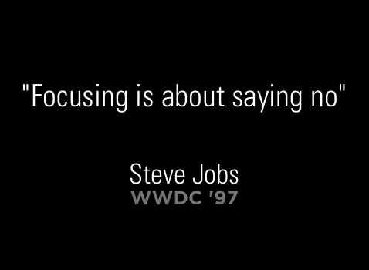

Slide 6

Cut Before You Add
Fact: No matter how large or small, every organization has limited resources to execute strategy.
Review the value of the current projects against executing your strategy.
Cut current projects, tasks and activities so you can execute on what’s really important.
Reference: Excellence in Execution: How to Implement Your Strategy by Robin Speculand
Notes:
Action #3 is to “cut before you add.” In most cases, it is important to trim back current programs, products, services, or processes, so the team can focus on what’s most important in terms of executing the strategic operating plan.
No matter how large or small, every organization has limited time, human and financial resources. It does much harm to roll out a new set of strategic initiatives to a workforce that is already stretched too thin.
Always err on the side of overestimating required resources to execute your strategy while underestimating available resources. Simultaneously, carefully review the value of the current projects against the proposed new strategic objectives.

Slide 7
Decision Tree to “Make the Cut” (for Public/NP Sectors)
Does the work have direct and significant impact to our strategy?
Does the work easily attract support and/or funding?
Are there many others doing this work?
Is this work a good fit with our core competencies?
What do we do?
Leaders pull a list of candidate activities
Yes
Strengthen
Yes
No
Assess ROI on Capacity Building
Yes
Yes
Grow
Existing Programs, Products & Services, Projects and Processes
No
Yes
No
Move Aggressively or Phase Out
Yes
Phase Out via Collaboration
Yes
No
Cut Now
No
Yes
“Charity”– Assess
No
No
Cut or Re-evaluate Assumptions
Yes
Doesn’t Matter
Phase Out Cautiously
No
No
Doesn’t Matter
Cut Now
Modified from this article: https://trinaisakson.com/wp-content/uploads/2014/04/27-Shift-MacMillan-Matrix-as-Decision-Tree.pdf
Notes:
To facilitate this process, begin by preparing a list of candidate activities to evaluate for continuation using a decision tree tool modified from the MacMillian Matrix. In this tool, we identify four major criteria to consider when evaluating a specific business activity and what to do with it once the evaluation is complete.
Does the work have direct and significant impact to our strategy?
Is the work currently profitable?
Are there many others doing this work?
Is this work a good fit with our core competencies?
As you move from left to right, the tree leads you to a decision about how to treat the priority, project, process, product or program in question.
This tool is designed to generate team collaboration and decision-making around what should be cut BEFORE we begin to add new initiatives. Take time to study the decision tree.

Slide 8


Break-out
Exercise
Cut Before You Add
Work at your breakout group to conduct “cutting” exercise for your organization.
Select three existing programs, products/services, projects or processes, evaluate them using the decision tree.
Discuss implications and draw preliminary conclusions on next steps.

Slide 9
Thank You!
http://lblstrategies.com

Slide 10
Strategy Work Sessions
Federal Foresight Community of Interest
October 24, 2019 Speaker: Doug Maris

Slide 11
Agenda
Time | Exercise Topics
11:15 – 12:00 | Exercise #1 - Environmental Scanning Tips and Techniques Breakout: Build out Trend Cards related to U.S. Government Inter-Agency future opportunities and threats; Place opportunities within Ansoff’s Grid
12:00 – 12:45 | Lunch (on own)
13:00 – 13:45 | Exercise #2 – Cut Before You Add “Cut Before You Add” Decision Tool Breakout: Apply tool regarding own situation
14:00 – 14:45 | Exercise #3 – Initiative Prioritization 2x2 Matrix Breakout: Apply tool to pre-populated opportunities/initiatives for FFCOI

Slide 12
Initiative Prioritization
Notes:
Welcome to Phase 2 of our Mastering Strategy course. Once the scope of the strategic management program has been determined by your team, as outlined in Phase 1, the process of strategic management moves into thoughtful analysis and evaluation of the strategic environment facing the organization.
Now, let’s get started with Phase 2: Environmental Assessment.

Slide 13

I strongly believe in ruthless prioritization. Sometimes people think of prioritization as only doing things that will have a positive impact on your business. But ruthless prioritization means only focusing on the very best ideas. It means figuring out the 10 things on your list and, if you can't do all 10, doing the top two really well. Ruthlessly prioritizing can get hard because you're always trying to do more, but it's one of the best and most important ways to stay focused.
Sheryl Sandberg – COO
https://www.cnn.com/2018/10/03/success/sheryl-sandberg-profile/index.html
Notes:
The wisdom of “prioritization” now becomes critically important. Why? Because RESOURCES ARE LIMITED!!!
Sheryl Sandberg, COO of Facebook got it right making this point. “I strongly believe in ruthless prioritization. Sometimes people think of prioritization as only doing things that will have a positive impact on your business. But ruthless prioritization means only focusing on the very best ideas. It means figuring out the 10 things on your list and, if you can’t do all 10, doing the top two well. Ruthlessly prioritizing can get hard because you’re always trying to do more, but it’s one of the best and most important ways to stay focused.”
Take a moment now to consider whether your team is good at prioritizing.

Slide 14
Charles’ Dilemma

Slide 15


Slide 16

Prioritize, prioritize, prioritize!
Employees only have so much time for executing “new initiatives”.
Focus on the vital few, not the trivial many.
Focus on first things first.

Slide 17
Prioritization Technique - 2x2 Matrix
Initiatives
10
9
8
7
6
5
4
3
2
1
I
We need it
II
We should do it
SNF Quiz
(4 initiatives):
Convert to EHR
Invest Here
Be Selective
Refurbish kitchen & dining room
Expected ROI / Benefit
We should do it
It would be nice to do
III
IV
Provide outpatient therapy services
Be Selective
Expand & enhance therapy gym for Med-A rehab-to-home
Consider Later
10 9 8 7 6 5 4 3 2 1
Strategic Importance / Urgency / Mission Critical
Notes:
Electric Health Record

Slide 18
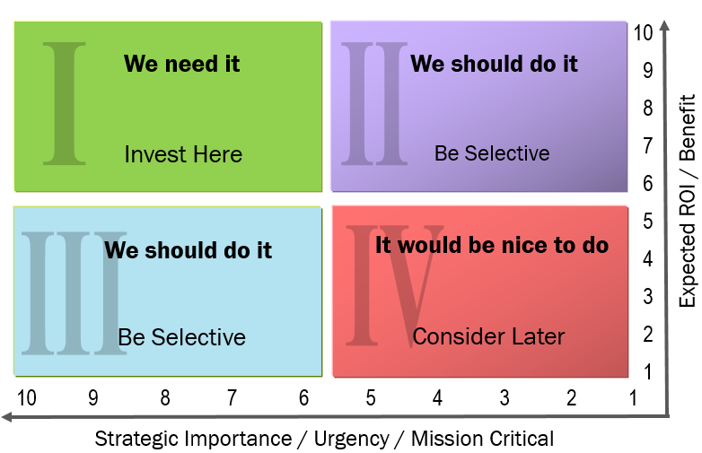
Break-out
Exercise
Prioritization Exercise
Share at your breakout group three initiatives you are currently working on for FFCOI. Discuss which quadrant each initiative falls and why.
Report out to build prioritized list of initiatives

Slide 19
Thank You!
http://lblstrategies.com

