Slide 1





Strategy Work Sessions Federal Foresight Community of Interest
October 24, 2019 Speaker: Doug Maris

Slide 2





Doug Maris
Certified:
Strategic Management Professional
Strategic Planning Professional
Balanced Scorecard Professional
Twenty-five years executive leadership and strategy experience
Strategic Management Certificate – DePaul University
M.A. / M.Div. – Lincoln Christian University
Course instructor:
DePaul University
George Washington University
Lincoln Christian University
Eleven years in senior living/healthcare:
Senior Director of Business Development
Executive Director & LNHA for three large CCRCs
Currently serving on board of directors for ATDChi
Six years as board member for Abraham Lincoln Memorial Hospital
As Senior Director of Business Development, developed, launched, and led a strategic planning cycle for a large nonprofit organization with 2,200 employees and $175 million annual budget
Enjoys attending children’s extracurricular sports and activities, reading, boating, golf, and the Chicago Cubs (sometimes)

Slide 3








Who Are We and What We Do
Our Mission: We help our clients focus, make better decisions and grow by instilling the ability to think and act strategically.
WE ARE MEMBERS:

Slide 4
Agenda
Time | Exercise Topics
11:15 – 12:00 | Exercise #1 - Environmental Scanning Tips and Techniques Breakout: Build out Trend Cards related to U.S. Government Inter-Agency future opportunities and threats; Place opportunities within Ansoff’s Grid
12:00 – 12:45 | Lunch (on own)
13:00 – 13:45 | Exercise #2 – Cut Before You Add “Cut Before You Add” Decision Tool Breakout: Apply tool regarding own situation
14:00 – 14:45 | Exercise #3 – Initiative Prioritization 2x2 Matrix Breakout: Apply tool to pre-populated opportunities/initiatives for FFCOI

Slide 5
Environmental Scanning
Notes:
Welcome to Phase 2 of our Mastering Strategy course. Once the scope of the strategic management program has been determined by your team, as outlined in Phase 1, the process of strategic management moves into thoughtful analysis and evaluation of the strategic environment facing the organization.
Now, let’s get started with Phase 2: Environmental Assessment.

Slide 6
Key Environmental Variables
Macro Level Trends
Macro Environment
Socio-cultural
Forces
Environmental
Forces
Political/
Legal /
Regulatory Forces
Technological
Forces
The
Organization
Economic
Forces
Notes:
Many factors in the macro-environment affect management decisions on what strategies to pursue to satisfy customers and stakeholders. Macro-environmental forces are broad-based trends, global or domestic in scope, that impact and/or influence the overall performance of the organization.
[Click] Economic factors. Interest rates, taxation changes, economic growth, inflation and currency value and exchange rates
[Click] Social factors. Demographics and changes occurring in the lives of people and society
[Click] Technological factors. New technologies and their impact on society
[Click] Environmental factors. Global warming, climate change, and extreme weather events impact on the planet
[Click] Political factors. Political changes to governments, trade, and policy both foreign and domestic
[Click] Legal factors. Changes to the legal and regulatory environment in which governments, society, and corporations operate
Again, take time to consider each of these factors and evaluate their likely impact on your organization.

Slide 7
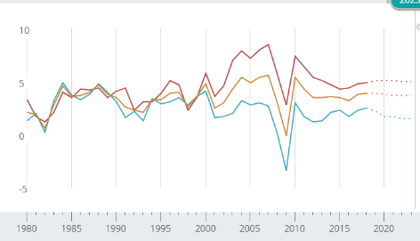
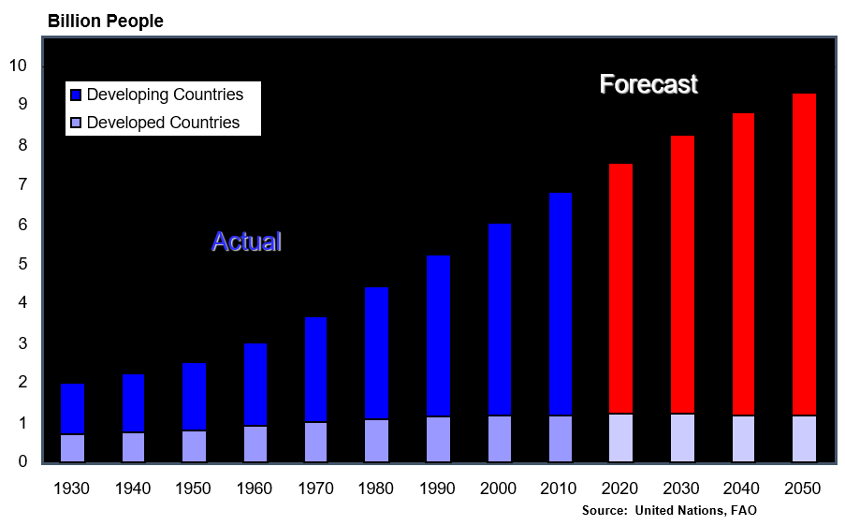
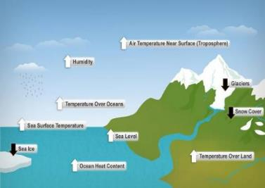

Macro Trends Examples
Global GDP Trend
World Population Growth Projections
Reference:
© Greg Schweitzer, Hillshire Brands. Used and adapted with permission by LBL Strategies, Ltd.
© Dr. Don Wuebbles, UIUC. Used and adapted with permission by LBL Strategies, Ltd.
http://www.imf.org/external/datamapper/NGDP_RPCH@WEO/OEMDC/ADVEC/WEOWORLD
Climate Change
Artificial Intelligence
Notes:
Examples of macro-level trends includes world population growth, climate change, artificial intelligence and domestic and global economic growth patterns.
Each trend can be analyzed using a combination of generic and specific questions to drive team thinking and input into the process. Generic questions relate to all or most dimensions, while specific questions pertain to each dimension or subtopic. The questions to be used are best formulated by members of the organization undertaking the strategic analysis. Examples of generic questions follow.
Which forces (or factors) should receive the greatest attention?
How sensitive is the organization to changes in a force?
What is the rate of change of these forces?

Slide 8

Notes:
What will the world of 2028 look like? This is a question St Paul's School has been asking as it explores what a rapidly changing world will be like when its youngest students reach their final year of education. Please watch this video of their research findings.

Slide 9
Key Environmental Variables
Micro level trends
Macro Environment
Socio-cultural
Forces
Environmental
Forces
Micro Environment
Political/
Legal /
Regulatory Forces
Technological
Forces
Stockholders
Competitors
Governments
Employees/
Labor Unions
The
Organization
Economic
Forces
Customers
Suppliers
Creditors
Trade
Associations
Communities
Special Interest Groups
Notes:
The second level of analysis is to examine the micro-level external environment. It is useful to break the micro-level analysis of forces and trends into two parts: an industry or sector analysis and an organizational environment analysis. Industry analysis can be considered a high-level profile that can be made without considering the organization except to recognize it as being part of the industry. An organizational environment analysis is concerned with the specific external relationships and key stakeholders of one-specific organization. Here are some examples of micro-level variables. [Click]
Micro-level forces and factors can be analyzed from generic and specific perspectives in the same manner as macro-level concerns. Examples of generic questions follow.
What trends will impact the markets and customers we serve?
What is the organization’s competitive landscape?
In what markets should the organization participate in what markets should be avoided?
What products and services should be provided to satisfy customer needs?

Slide 10
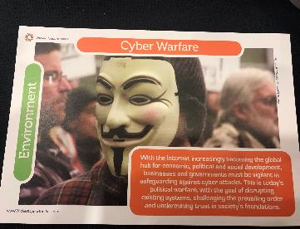
Trend Cards – Robin Champ
Why are these Cards important? Benefits and Use:
Stimulate outside the box thinking
Use in foresight workshops
Information dissemination for senior executives
Way to catalog/quantify trends/signals for research
Tangible pictures, cards vs. abstract words
Here are some sample Trend cards from MITRE
Hand out 2-3 per table

Slide 11


Break-out Exercise
Trend Cards – Robin Champ
Definitions:
Trend: Direction in which something is changing.
Weak Signal: What is coming down the pike that could be a huge disruptor/surprise. Not an established trend yet.
Social: Includes demographics, culture, values
Technology: includes innovation, sciences
Economic: Includes commerce, money, markets, financial
Political: Includes leadership, governance, nation states, VEOs, etc
Environment: Includes climate, geography, Virtual environments, places
At your tables, please develop 3 to 5 trend cards. This can be for your Agency, or for the Govt writ large.
Include data such as:
Name of the Trend or Weak Signal
What is the category? (example: social, technology, economic, political, environment)
Provide 1 to 2 line description of Trend/Weak Signal.
Provide 1 to 3 implications of this Trend/Weak Signal to the US Govt/Your Agency.
Pictures for extra credit!

Slide 12
Igor Ansoff’s Grid
CURRENT MARKETS
NEW MARKETS
CURRENT
SERVICES /
PRODUCTS
Market
Penetration
Market
Development
Increasing Risk
NEW
SERVICES /
PRODUCTS
Service / Product
Development
Diversification
Reference: Ansoff, Igor H. Corporate Strategy. New York: McGraw Hill, 1965
Increasing Risk
Notes:
To maximize effectiveness of the evaluation process, the team facilitator should categorize each market opportunity using the 4 dimensions of Ansoff’s Grid. For example, [Click] opportunities to take current products or services to current markets falls in the top left quadrants, [Click] “Market Penetration”; [Click] Whereas approaching our current markets with new products is in the bottom left quadrant [Click], “Service and Product Development” ; [Click] The right side of the grid is for opportunities identified in new markets, [Click] either with current products in the [Click] top right; or [Click] new products in the [Click] bottom right. In general, every market-based opportunity can be categorized as being a market penetration, market development, product/service development, or diversification opportunity.
[Click] By sorting market-based opportunities using Ansoff’s grid it provides a glimpse into the primary strategic choices facing the team. In all cases the associated risk grows when a team decides to pursue markets or products/services that are new to the organization and should be evaluated accordingly.

Slide 13
Igor Ansoff’s Grid Example Windy City Shoes Opportunities
CURRENT MARKETS
NEW MARKETS
CURRENT
SERVICES /
PRODUCTS
There’s a brand recognition of Windy City Shoes in the greater St. Louis region
Growing demand of Windy City Shoes in Chicagoland
NEW
SERVICES /
PRODUCTS
Customers looking for socks and gloves reported by staff at Chicagoland locations
There’s a trend that people shop for shoes and socks together in Western Europe
Notes:
A simplified Ansoff’s Grid example can be seen in the case of Windy City Shoes, a fictitious Chicagoland shoe store. Please drag and drop each of the opportunities into the appropriate quadrant.

Slide 14

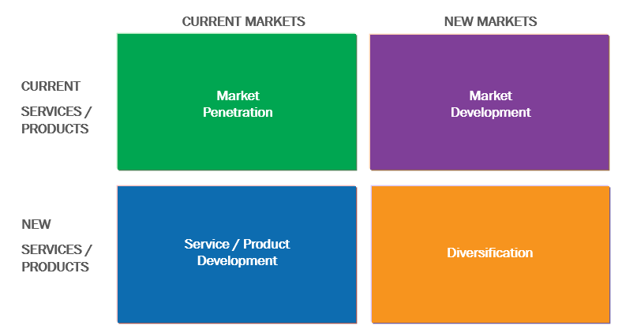
Break-out Exercise
Ansoff’s Grid
Based on the Trend Cards exercise, use Ansoff’s Grid to plot identified opportunities in four quadrants.
Are there other opportunities on the horizon to include as well?
Report out to the group.
Notes:
As noted earlier, throughout the course we’ll give you opportunities to apply tools that will help your team succeed.
For this exercise identify a list of threats facing your organization; use the Heat Map Exposure Matrix to assess and prioritize these threats; then summarize the implications and discuss the implications with your team.

Slide 15
Thank You!
http://lblstrategies.com

