Slide 1





Strategy Work Sessions
Federal Foresight Community of Interest
October 24, 2019 Speaker: Doug Maris

Slide 2
Agenda
Time | Exercise Topics
11:15 – 12:00 | Exercise #1 - Environmental Scanning Tips and Techniques Breakout: Build out Trend Cards related to U.S. Government Inter-Agency future opportunities and threats; Place opportunities within Ansoff’s Grid
12:00 – 12:45 | Lunch (on own)
13:00 – 13:45 | Exercise #2 – Cut Before You Add “Cut Before You Add” Decision Tool Breakout: Apply tool regarding own situation
14:00 – 14:45 | Exercise #3 – Initiative Prioritization 2x2 Matrix Breakout: Apply tool to pre-populated opportunities/initiatives for FFCOI

Slide 3
Initiative Prioritization
Notes:
Welcome to Phase 2 of our Mastering Strategy course. Once the scope of the strategic management program has been determined by your team, as outlined in Phase 1, the process of strategic management moves into thoughtful analysis and evaluation of the strategic environment facing the organization.
Now, let’s get started with Phase 2: Environmental Assessment.

Slide 4

I strongly believe in ruthless prioritization. Sometimes people think of prioritization as only doing things that will have a positive impact on your business. But ruthless prioritization means only focusing on the very best ideas. It means figuring out the 10 things on your list and, if you can't do all 10, doing the top two really well. Ruthlessly prioritizing can get hard because you're always trying to do more, but it's one of the best and most important ways to stay focused.
Sheryl Sandberg – COO
https://www.cnn.com/2018/10/03/success/sheryl-sandberg-profile/index.html
Notes:
The wisdom of “prioritization” now becomes critically important. Why? Because RESOURCES ARE LIMITED!!!
Sheryl Sandberg, COO of Facebook got it right making this point. “I strongly believe in ruthless prioritization. Sometimes people think of prioritization as only doing things that will have a positive impact on your business. But ruthless prioritization means only focusing on the very best ideas. It means figuring out the 10 things on your list and, if you can’t do all 10, doing the top two well. Ruthlessly prioritizing can get hard because you’re always trying to do more, but it’s one of the best and most important ways to stay focused.”
Take a moment now to consider whether your team is good at prioritizing.

Slide 5
Charles’ Dilemma

Slide 6


Slide 7

Prioritize, prioritize, prioritize!
Employees only have so much time for executing “new initiatives”.
Focus on the vital few, not the trivial many.
Focus on first things first.

Slide 8
Prioritization Technique - 2x2 Matrix
Initiatives
10
9
8
7
6
5
4
3
2
1
I
We need it
II
We should do it
SNF Quiz
(4 initiatives):
Convert to EHR
Invest Here
Be Selective
Refurbish kitchen & dining room
Expected ROI / Benefit
We should do it
It would be nice to do
III
IV
Provide outpatient therapy services
Be Selective
Expand & enhance therapy gym for Med-A rehab-to-home
Consider Later
10 9 8 7 6 5 4 3 2 1
Strategic Importance / Urgency / Mission Critical
Notes:
Electric Health Record

Slide 9


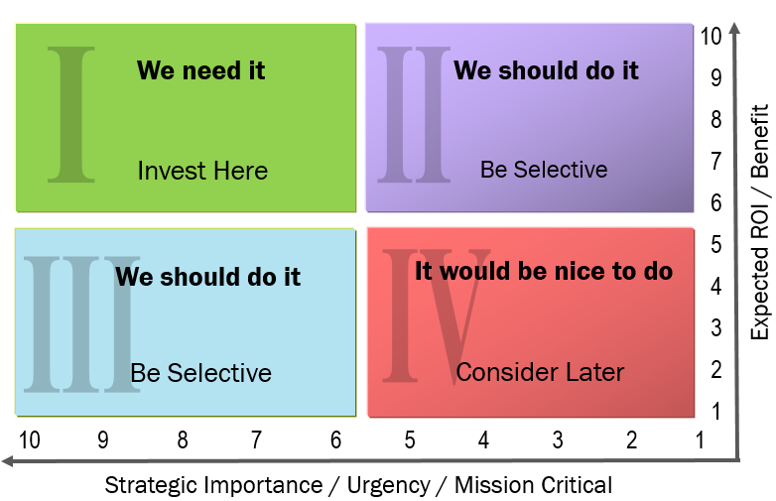
Break-out
Exercise
Prioritization Exercise
Share at your breakout group three initiatives you are currently working on for FFCOI. Discuss which quadrant each initiative falls and why.
Report out to build prioritized list of initiatives

Slide 10
Thank You!
http://lblstrategies.com

