Slide 1
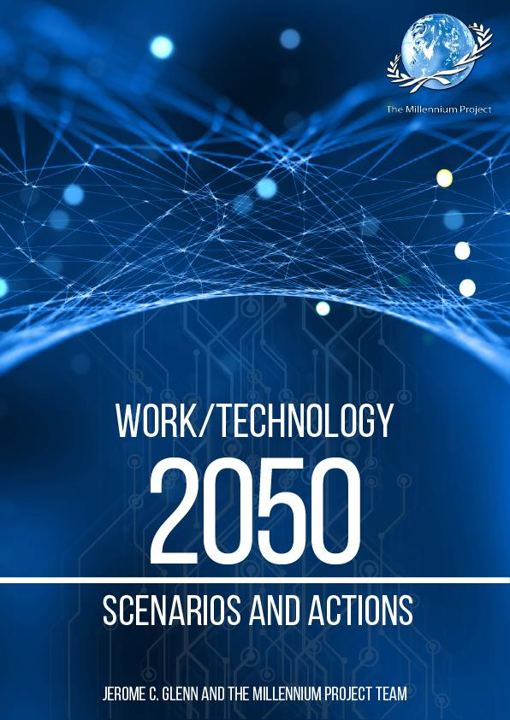
A Three-Year Global Study on what to do about Potential Futures for Work and Technology Actions Jerome C. Glenn, CEO The Millennium Project

Slide 2
Inevitability of New Economics, Changing social contract and human rights
Concentration of wealth is increasing
Income gaps are widening
Employmentless economic growth seems the new norm
Return on Investment in capital and technology is usually better than labor
Future technologies can replace much of human labor
Long-term structural unemployment is a “business as usual” or “surprise free” trend forecast
What can we do about this?

Slide 3
Future Work/Technology 2050 Study
Literature and Related Research Review
Real-Time Delphi on questions not asked or poorly answered
Three Global Scenario Drafts to 2050
Three Separate RTDelphi’s for Feedback on each Scenario
Final Scenarios, given for Millennium Project Nodes
National Workshops to Explore Long-range Strategies
Collect suggestions from the national planning workshops, distilled in to 93 actions, assess all via five (5) Real-Time Delphi's
Final Report for Public Discussion

Slide 4
Three Forms of Artificial Intelligence
Artificial Narrow Intelligence
Artificial General Intelligence
Artificial Super Intelligence

Slide 5
Next Technologies (NT): Imagine How NT Synergies Will Create New Businesses
Artificial Intelligence
Robotics
Synthetic Biology & Genomics
Computational Science
Cloud & Big Data Analytics
Artificial & Augmented Reality
Nanotechnology (two kinds)
IoT, Tele-Everything & Tele-Everybody, the Semantic Web
Quantum computing
Tele-Presence, Holographic Communications
Intelligence augmentation
Collective Intelligence
Blockchain
3D/4D Printing Materials/Biology
Drones, Driverless Cars (and other autonomous vehicles)
Conscious-Technology
Synergies Among These

Slide 6
The Old Way of Seeing the Future of Technologies: Linear and Separate
Artificial
Intelligence
Robotic
manufacturing
Artificial General Intelligence
Drones
Tele-Everything &
Tele-Everybody
the Semantic Web
Quantum computing
Nanotechnology
Synthetic Biology
3-D4-D Priting
Computational Science

Slide 7
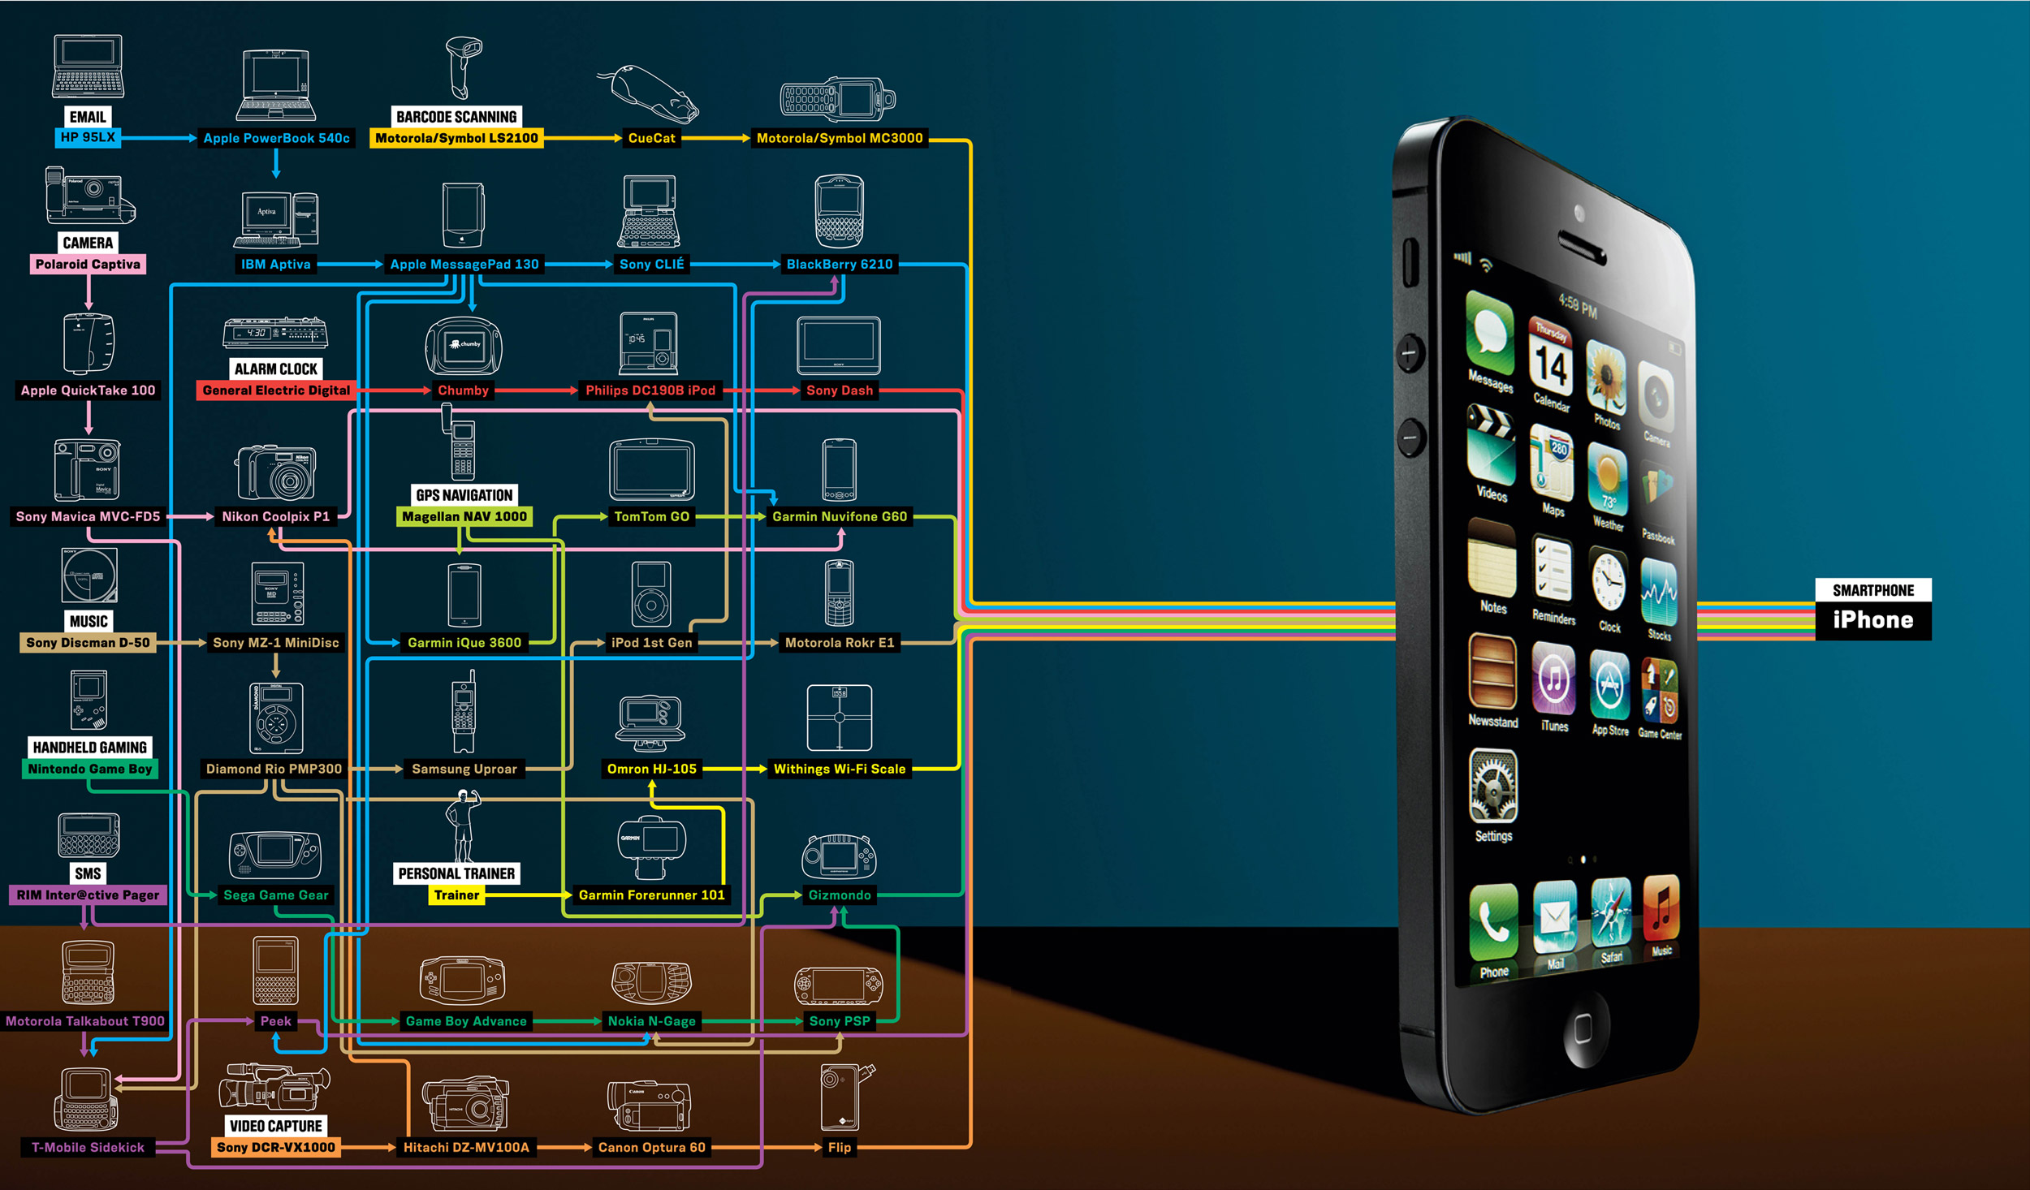
Future Way of Seeing Future of Technologies: Integration and Synergies

Slide 8
Future Synergies
Robotic
manufacturing
Synthetic Biology
Increasing individual and collective intelligence
Quantum computing
Drones
Nanotechnology
Robotic
manufacturing
Artificial General Intelligence
3D，4D Printing
Tele-Everything
Tele-Everybody
the Semantic Web
Augmented Reality
Tele-Presence
Holographics
Nanotechnology

Slide 9
Future Synergies
Robotic
manufacturing
Artificial
Intelligence
Future Technology
Quantum computing
Drones
Robotic
manufacturing
Augmented Reality,
Tele-Presence,
Holographics
3D，4D Printing

Slide 10
Work/Tech Global Scenarios 2050
Each scenario is about 10 pages of detailed cause & effect sequences that illustrate decisions
It’s Complicated - A Mixed Bag
Political/Economic Turmoil – Future Despair
If Humans Were Free – The Self-Actualizing Economy

Slide 11
Global Employment Assumptions Workforce 3 billion 2000; 6 billion 2050
 | Scenario 1 Business as Usual | Scenario 2 Political Turmoil | Scenario 3 Self-Actualization
Employed | 2 Billion | 1 Billion | 1 Billion
Self-Employed | 2 Billion | 1 Billion | 3 Billion
Unemployed or in transition | 1 Billion | 2 Billion | 1 Billion
Informal Economy | 1 Billion | 2 Billion | 1 Billion

Slide 12
Scenario 1:
It’s Complicated – A Mixed Bag
A business-as-usual trend projection
Increasing acceleration of change with both intelligence and stupidity
Irregular adoption of advance technology
Major employment growth in Biotech Industries
High unemployment where governments did not create long-range strategies
Mixed success on the use of universal basic income.
Giant corporations grow beyond government control, in this government-corporate, virtual-3D, multi-polar world of 2050.

Slide 13
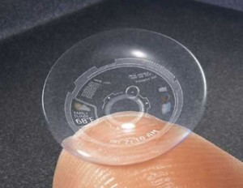
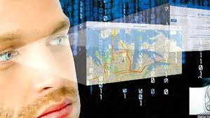
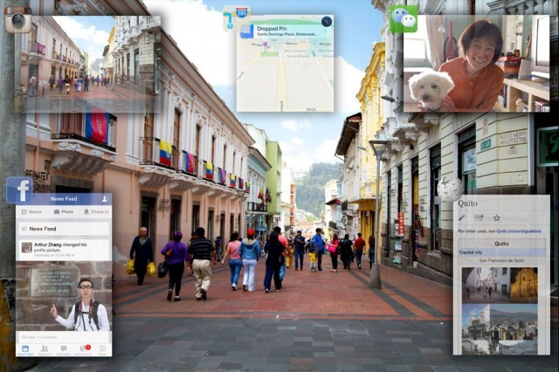
IoT AI Contact Lens – always in Virtual and Augmented Reality connected to the word
Hands-free, phone-free, laptop-free, AI-Human symbiosis

Slide 14
Human Augmentation: AI-Brain Interface as a “Neural Lace”
https://www.neuralink.com/ is hiring now
The World
Artificial Intelligence
Human Brain
“Neural lace:” a mesh of electronics [and photonics] that will allow AI and the brain to work together. – Elon Musk
This could help human brains keep up with future enhancements in AI.

Slide 15
Technologically enhanced human intelligence
Source CBINSIGHTS

Slide 16
…will be connected to the Internet of Things
And our Robots…
Source: medium.com

Slide 17
Scenario 2:
Political/Economic Turmoil – Future Despair
Political grid-lock increases social polarization, prevents decisionmaking
Political, economic, environmental migrations increase ethnic conflicts
Governments did not anticipate impacts of artificial general intelligence: hence, no strategies to address increasing mass unemployment
Unemployment exploded in the 2030s leads to 2050 in political turmoil
Financial systems cannot support ageing societies, financial crises
World order has deteriorated into a combination of nation-states, mega-corporations, local militias, terrorist groups, and organized crime

Slide 18
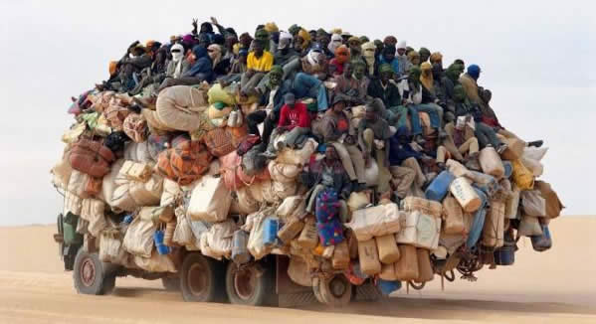
Scenario 2 Jobless Migrations

Slide 19
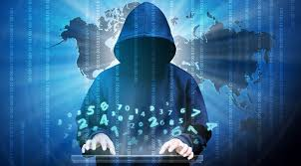
In Scenario 2 AI makes this Combination Far More Powerful…
Organized Crime
Corruption
Terrorism
…Making Democracy and Free Markets…
Information Warfare
…An Illusion

Slide 20
Scenario 3:
If Humans Were Free
the Self-Actualization Economy
Governments did anticipate the impacts of artificial general intelligence
Conducted extensive research on how to phase in universal basic income systems
Increasing intelligence becomes a goal of education
Self-employment promoted
Artists, media moguls, and entertainers helped to foster cultural change from an employment culture to a self-actualization economy.

Slide 21
Maslow’s Hierarchy of Needs

Slide 22
Scenario 3 Your Personal AI Avatar searches the web while you sleep…
… then wakes you up in the morning ….with all kinds of interesting things to do, some for income, some because the are just fun, and some that are both all with smart contacts if needed.

Slide 23
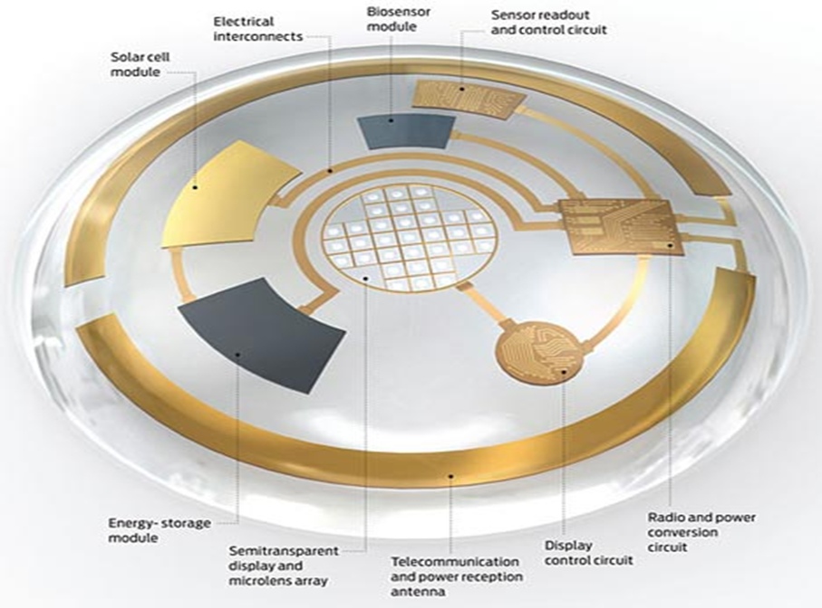
Steve Jobs and Bill Gates 1991
Consider what these two geniuses created!
By 2030-2050 millions of people could become augmented geniuses, and what could we create?
Source: reddit.com/r/OldSchoolCool/

Slide 24
Future Work/Tech 2050 Workshops
Initial workshops | Initial workshops | In planning | Exploratory talks
1. Argentina (2 and series) | 11. Italy (2, and 3rd in planning) | China | Australia
2. Bolivia (series) | 12. The Netherlands (2) | El Salvador | Croatia
3. Brazil (Sao Paolo) | 13. Mexico (2) | Peru (2030 study first) | Dubai, UAE
4. Bulgaria | 14. Poland | Kenya | Egypt
5. European Foresight Network | 15. Spain (3) | Pakistan | Georgia
6. Finland | 16. South Africa | Romania | India
7. Germany (series) | 17. South Korea (2) | Slovakia | Iran
8. Greece | 18. Uruguay (series in progress) | Sri Lanka | Montenegro
9. Hungary | 19. Venezuela | Zambia | Slovenia
10. Israel (2) | 20. United States (2) |  | Turkey
 |  |  | United Kingdom

Slide 25
Actions to Address issues in the Work/Tech 2050 Global Scenarios
Workshop Discussion Group | Actions Assessed | Additional Suggested Actions
Education and Learning | 20 | 26
Government and Governance | 22 | 26
Business and Labor | 19 | 23
Culture, Arts, and Media | 17 | 18
Science and Technology | 15 | 25
Totals | 93 | 118

Slide 26
Some examples of 93 actions assessed
Make increasing intelligence an objective of education.
In parallel to STEM education create a hybrid system of self-paced inquiry-based learning for self-actualization, creativity, critical thinking, and human relations using new AI tools.
Create international standards for narrow and general AI with a governance system to enforce them (maybe similar to the International Atomic Energy Agency – IAEA).​​
Produce alternative cash flow projections for universal basic income to see if/when it is financially sustainable.​
Put memes in advertisements to help the cultural transition to new forms of economics and work.​
Create personal AI/Avatars able to match peoples' skills and interests with income opportunities worldwide which can make smart contracts to support self-employment.​
Shift education/learning systems more toward mastering skills than mastering a profession.​
Public/private research should explore the cultural transition for a new social contract between the government and the citizens who potentially could be both unemployed and augmented geniuses.​
Art/media/entertainment leaders should engage the public in anticipating cultural changes due to potential impacts of future technologies.

Slide 31
Drawn from the forthcoming Work/Technology 2050: Scenarios and Actions

Slide 32
A few words about
The Millennium Project

Slide 33
… Acts like a TransInstitution
UN Organizations
Universities
The Millennium Project
Corporations
Governments
NGOs
and
Foundations
Notes:
33

Slide 34
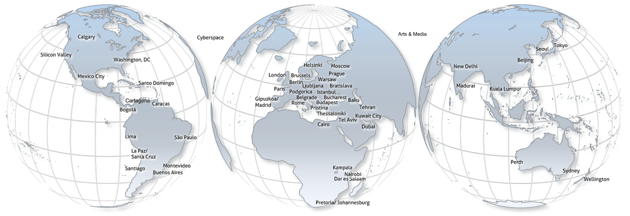
65 Nodes...and two regional networks in Europe and Latin America
are groups of experts and institutions that connect global and local views in:
Yerevan
Sri Lanka
Tunisia
Nodes identify participants, translate questionnaires and reports, and conduct interviews, special research, workshops, symposiums, and advanced training.

Slide 35
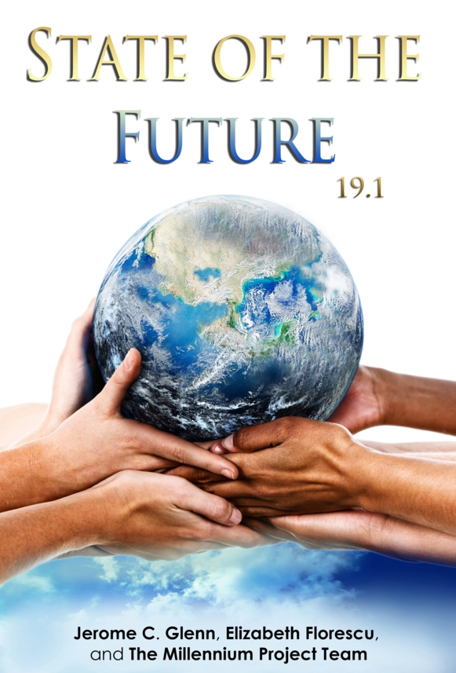
Preface Executive Summary Ch 1 Global Challenges Ch 2 2017 State of the Future Index Ch 3 Future Terrorism & Deterrence Ch 4 Work/Tech 2050 Scenarios and Workshop Strategies Ch 5 Conclusions Appendix

Slide 36
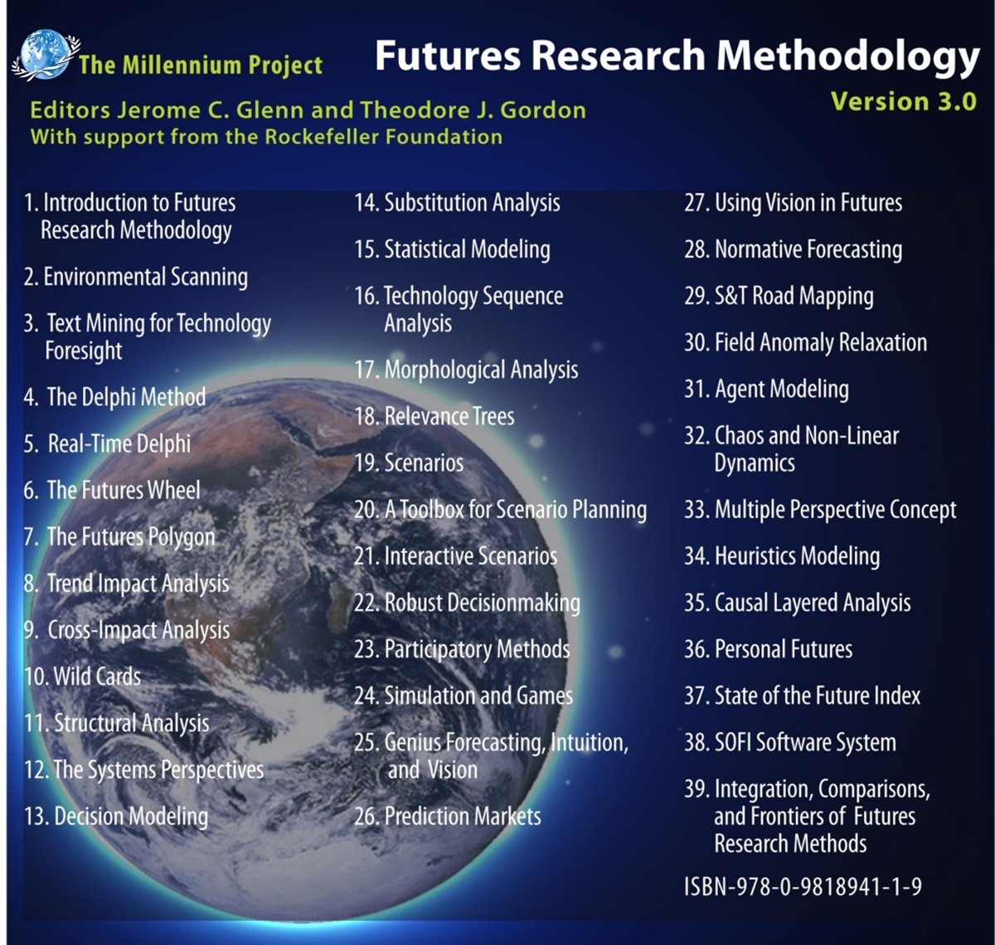
39 Chapters
37 Different Methods
1,300 pages
Largest collection of
Internationally peer-reviewed methods to explore the future ever assembled in one source

Slide 37
Millennium Project Futures Research… so far
African Futures Scenarios 2025, and UNDP workshop at the UN (1994)
Millennium Project Feasibility Study final report (1995)
Global Issues/Strategies four-round Global Lookout (Delphi) study (1996)
Lessons of History (1997)
Global Opportunities and Strategies Delphi (1997)
Definitions of Environmental Security (1997)
Futures Research in Decisionmaking (and checklist) (1998-99)
Global Normative 2050 Scenario (1998)
Environmental Security Threats and Policy Leadership (1998)
Current/Potential UN military doctrine on Environmental Security (1999)
Six Alternative Year 3000 Scenarios (1999)
S&T Issues over the next 25 years (2000)
Future Technological Implications for Society and the UN System (2000)
Analysis of UN Summit Speeches (2001)
Military environmental crimes and the role of the ICC (2001)
Management Implications of Future S&T 2025 Issues (2001)
New Military Environmental Security Requirements 2010-2015 (2001)
Global Goals for the year 2050 (2002)
Future S&T Scenarios 2025 (2002)
Emerging Environmental Security Issues for Future UN Treaties (2002)
Monthly Reports: Emerging Environmental Security Issues (2002-2011)
Middle East Peace Scenarios (2002-04)
Early Warning System for Kuwait Oil Company (2003-04)
Nanotech Military R&D Health/Env Research Prevention Priorities 2004-05)
Future Ethical Issues (2004-05)
Global Energy Scenarios (2006-07)
South Korea SOFI (2006)
Future of Learning and Education 2030 (2007)
Global Climate Change Situation Room for Gimcheon, South Korea (2007-2008)
Conceptual design for global energy collective intelligence (GENIS) (2008)
Status of Government Future Strategy Units (2008)
RTDelphi for UNESCO World Water Report (2008)
WFUNA Human Rights (2008)
Decision Criteria Evaluation of Global Environment Facility (2008)
South Korea SOFI and South African SOFI (2008)
Early Warning System PMO Kuwait (2008-2009)
Potential Future Elements of the Next Economic System (2009)
UNESCO World Water Scenarios project (2009)
Future of Ontologists (2009)
Future Hopes and Fears: a Kuwait Perspective (2010-2011)
Latin America 2030 Scenarios (2009-2011)
Egypt 2020 (2010)
Changes to Gender Stereotypes (2011)
Azerbaijan SOFI (2011)
Future Arts, Media, and Entertainment: Seeds for 2020 (2011)
Cooperatives 2030: Factors Impacting Future of Cooperatives and Business (2012)
Egypt’s national Synergetic Information System (ECISIS) (2013-16)
Hidden Hunger: Unhealthy Food Markets in the Developing World (2013)
Vulnerable Natural Infrastructure in Urban Coastal Zones (2013)
FUTURES Dictionary/Encyclopedia (English and Spanish) (2014)
SIMAD and Lone Wolf Terrorism Counter Strategies (2014)
Czech Rep., Hungary, Poland, Slovakia, Visegrad Region SOFIs (2014-2015)
Water-Energy-Food Nexus in the Context of Climate Change (2015-16)
Pre-Detection of Terrorism Strategies RTDelphi, NATO Workshop (2015-17)
Future Work/Technology 2050 Global Issues, Scenarios, Workshops (2015-18)

Slide 38
Integration of all our work into the Global Futures Intelligence System www.themp.org

Slide 39
For further information
The Millennium Project
Info@Millennium-Project.org
Work/Technology 2050: Scenarios and Actions
http://www.millennium-project.org/publications-2/
State of the Future 19.1
http://www.millennium-poject.org/state-of-the-future-version-19-1/
Futures Research Methodology 3.0
http://www.millennium-project.org/publications-2/#method
Global Futures Intelligence System
http://www.millennium-project.org/projects/global-futures-intelligence-system/

